Slide 1
JAVA ANNOTATION

Slide 2
Concept Of Marker Interface
Observe the below code !
Urgent urgent = new JobWork();
urgent.presentation();
urgent.coding();
interface Urgent {
void presentation();
}
class JobWork implements Urgent {
public void presentation(){}
public void coding(){}
}
Compile Error

Slide 3
Concept Of Marker Interface
Observe the below code !
Urgent urgent = new JobWork();
urgent.presentation();
urgent.coding();
interface Urgent {
}
class JobWork implements Urgent {
public void presentation(){}
public void coding(){}
}
Compile Error

Slide 4
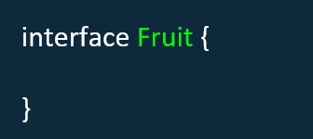
Concept Of Marker Interface
Marker interface doesn’t contain any method or field. They have empty body.

Slide 5
Concept Of Marker Interface
How Marker Interface can benefit for us ?

Slide 6
Marker Interface can only be beneficial when you need of marking or need to define metadata about a class.
Let’s take a scenario !
Out of multiple classes objects how will you manage that which class needs to be process first ? How will you handle this situation ?

Slide 7
This method is returning the
ArrayList of object of JobWork, HomeWork
and similar classes
class JobWork { }
class HomeWork { }
class Driver {
public static void main( String []args){
ArrayList<Object> li = getObjectList();
for(Object obj : li){
// What is the logic ?
}
}
}

Slide 8
Final Conclusion !
interface Urgent { }
class JobWork implements Urgent { }
class HomeWork { }
class Driver {
public static void main( String []args){
ArrayList<Object> li = getObjectList();
for(Object obj : li){
if(obj instanceof Urgent){
System.out.println(obj);
}
}
}
}

Slide 9
In earlier versions of Java, Marker Interfaces were the only way to declare metadata about a class.
But Java 1.5 onwards, marker interfaces have no place. They can be completely replaced by Annotations, which allow for a very flexible metadata capability.

Slide 10
How Annotation replaced Marker Interface ?
To find out the answer of above question we need to learn how to create our custom annotation.
Before moving ahead, collect some information about Annotation which will help us to understand creation of custom Annotation.

Slide 11
Built In Annotation
java.lang
@SuppressWarnings
@Deprecated
@Override
@SafeVarArgs
@FunctionalInterface

Slide 12
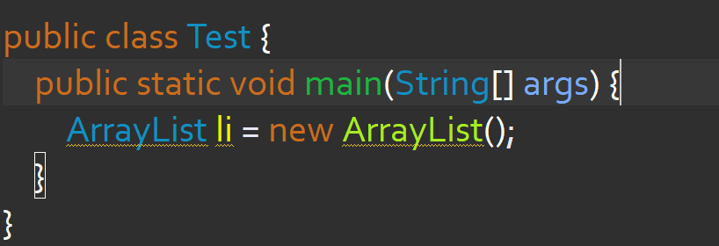
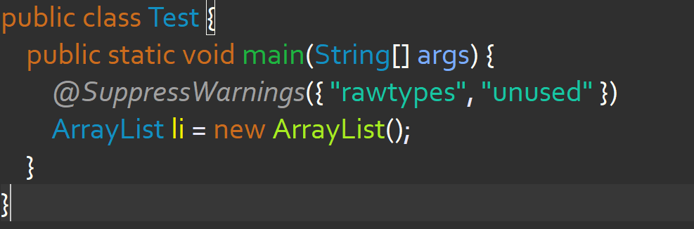
@SuppressWarnings

Slide 13
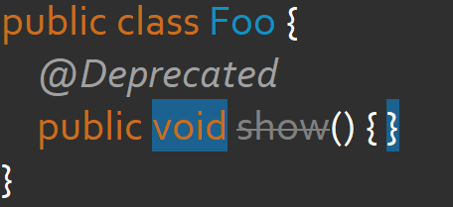
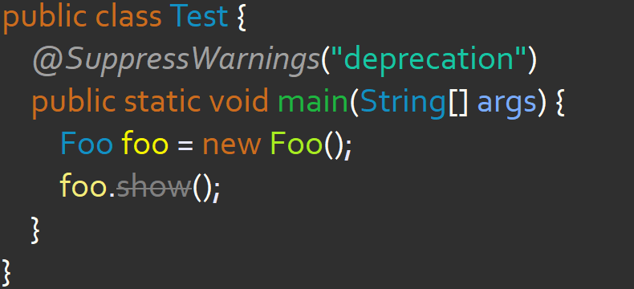
@Deprecated

Slide 14
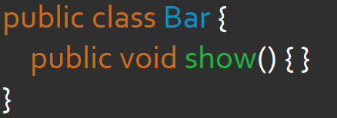
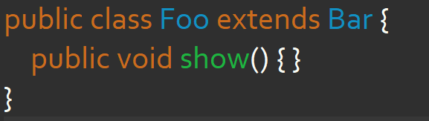
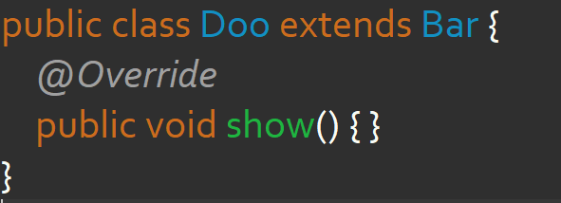
@Override

Slide 15
Built In Annotation
java.lang.annotation
@Target
@Retention
@Inherited
@Documented
@Repeatable

Slide 16
What is Meta Annotation ?
A meta annotation is an annotation that can be applied to another annotation. Built in meta annotations are shown below :
@Target
@Retention
@Inherited
@Documented
@Deprecated

Slide 17
Now we are all set to create our own Custom Annotation !

Slide 18
Creating Custom Annotation
Step 1
The first step toward creating a custom annotation is to declare it using the @interface keyword:
public @interface Urgent { }

Slide 19
Step 2
The next step is to add meta-annotations to specify the scope and the target of our custom annotation:
@Retention( RetentionPolicy.RUNTIME )
@Target( ElementType.Type )
public @interface Urgent { }

Slide 20
@Target
We can create 3 type of annotation on the basis of positioning :
Class Level Annotation
Field Level Annotation
Method Level Annotation
@Target meta-annotation is used to specify, what type of annotation is this.

Slide 21
@Target - Annotation Types
To create Class Level Annotation Use :
@Target(ElementType.TYPE)
To create Field Level Annotation Use :
@Target(ElementType.FIELD)
To create Method Level Annotation Use :
@Target(ElementType.METHOD)

Slide 22
@Target – Multi Type Annotation
Annotation can be of multiple type at the same time. For example, an annotation can be of Class Type as well as Method Type. To create such type of annotation use @Target by passing an array containing corresponding values as shown below :
@Target( {ElementType.TYPE, ElementType.METHOD} )

Slide 23
@Retention
We can pass 3 different value to this annotation.
@Retention( RetentionPolicy.SOURCE )
@Retention( RetentionPolicy.CLASS )
@Retention( RetentionPolicy.RUNTIME )
In 99% cases, we use RetentionPolicy.RUNTIME
Default value is RetentionPolicy.CLASS

Slide 24
@Retention
@Retention( RetentionPolicy.SOURCE )
This value make sure that annotation should only be in action until program didn’t compiled.
@Retention( RetentionPolicy.CLASS )
This value make sure that annotation should active even after compilation but inactive at runtime.
@Retention( RetentionPolicy.RUNTIME )
This value make sure that annotation should always be active even at runtime.

Slide 25
Custom @Urgent
@Target(ElementType.TYPE)
@Retention(RetentionPolicy.RUNTIME)
public @interface Urgent {
}

Slide 26
Final Conclusion !
@Urgent
class JobWork { }
class HomeWork { }
class Driver {
public static void main( String []args){
ArrayList<Object> li = getObjectList();
for(Object obj : li){
if(obj.getClass().isAnnotationPresent(Urgent.class)){
System.out.println(obj);
}
}
}
}

Slide 27
Type Of Annotation
Marker Annotation
Single-Value Annotation
Multi-Value Annotation

Slide 28
Marker Annotation
An annotation that has no method, is called marker annotation.
@interface MyAnnotation { }

Slide 29
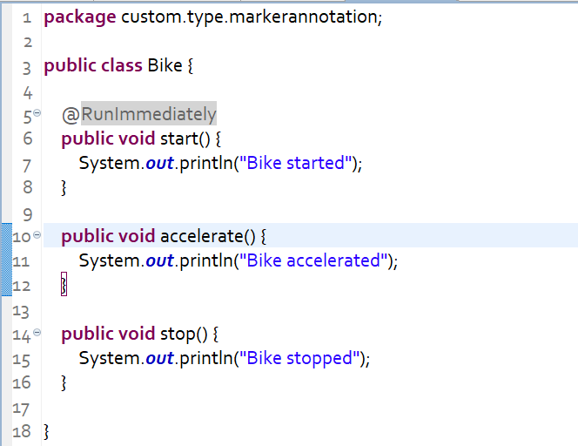
Marker Annotation Example
Bike.java

Slide 30
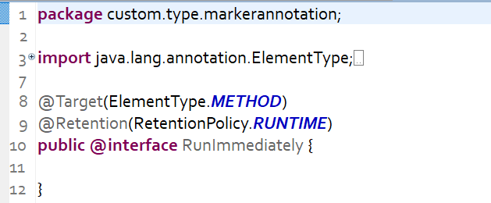
Marker Annotation Example
RunImmediately.java

Slide 31
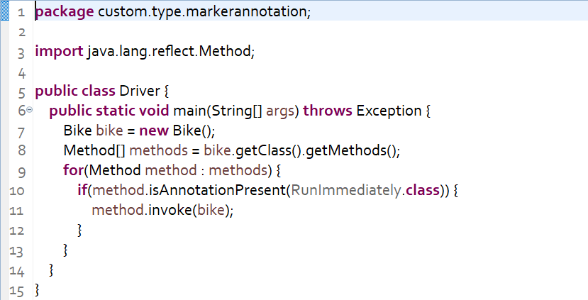
Marker Annotation Example
Driver.java

Slide 32
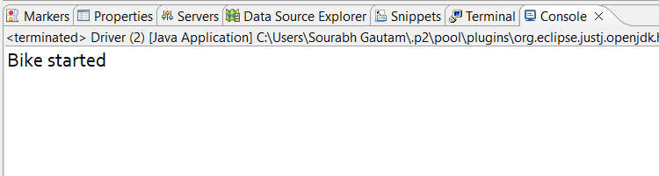
Output !

Slide 33
Single-Value Annotation
An annotation that has one method, is called single-value annotation.
@interface MyAnnotation {
int value();
}

Slide 34
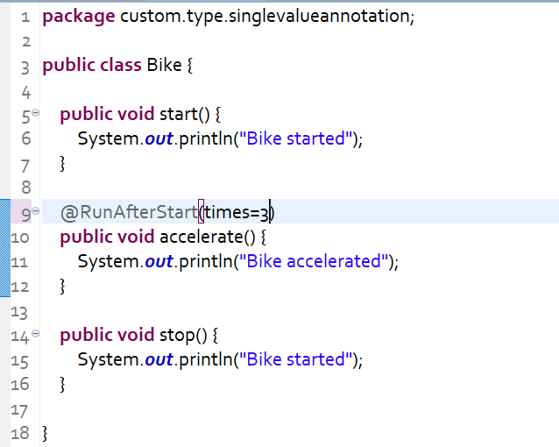
Single-Value Annotation Example
Bike.java

Slide 35
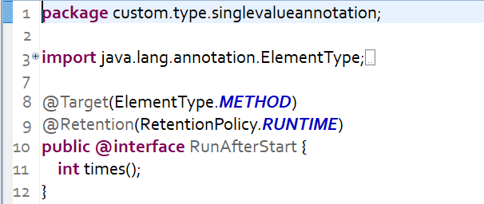
Single-Value Annotation Example
RunAfterStart.java

Slide 36
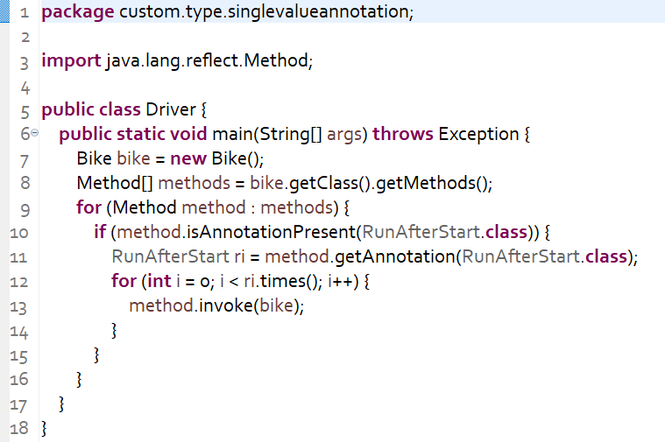
Single-Value Annotation Example
Driver.java

Slide 37
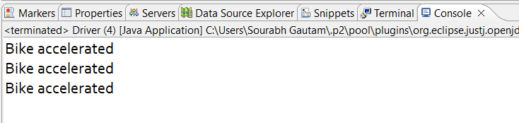
Output !

Slide 38
Default Value
@Target(ElementType.TYPE)
@Retention(RetentionPolicy.RUNTIME)
public @interface RunAfterStart {
int times() default 1;
}
Without default value, annotation force us to pass the number of argument equal to number of methods. In case of default value, even if don’t pass the argument it will use the default one.

Slide 39
Multi-Value Annotation
An annotation that has more than one method, is called Multi-Value annotation.
@interface MyAnnotation{
int value1();
String value2();
String value3();
}

Slide 40
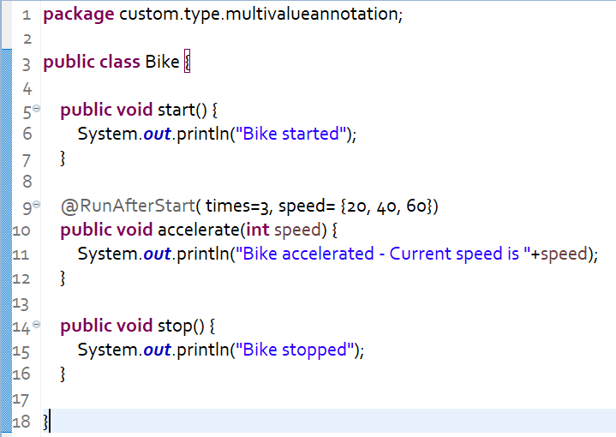
Multi-Value Annotation Example
Bike.java

Slide 41
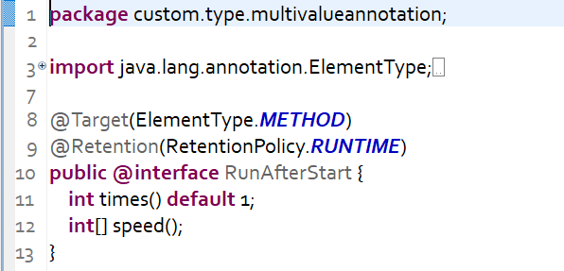
Multi-Value Annotation Example
RunAfterStart.java

Slide 42
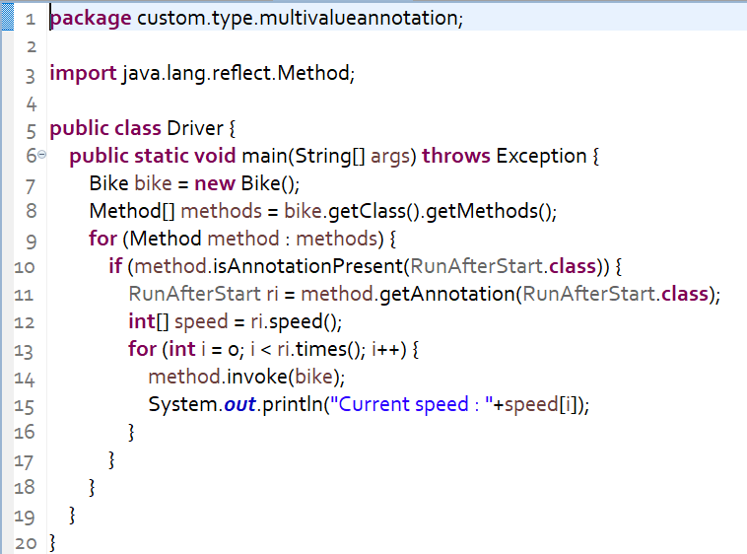
Multi-Value Annotation Example
Driver.java

Slide 43
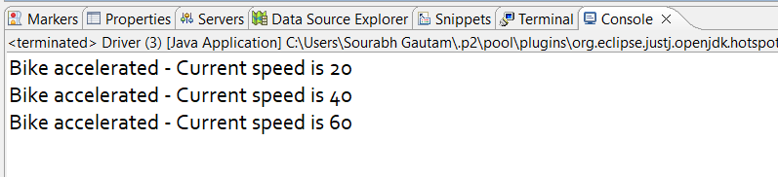
Output !

Slide 44
Thanks!
Any questions?

